Slide 1
Our Solutions are developed specifically to ensure ENHANCED INDUSTRIAL SAFETY and improved team communication to INCREASE EFFICIENCY AND PRODUCTIVITY.
COMMEND – INDUSTRIAL COMMUNICATIONS
Notes:
Arguments: Good team communication can help to prevent loss of production or at least reduce downtimes. The resulting cost savings will cover the costs of Commend solution in no time.

Slide 2
A revolutionary new series of Ex-proof Stations
Designed and manufactured in Austria

Slide 3
GAS
IIC Highest explosion protection rating
DUST
IIIC Highest explosion protection rating
Zone 1
II 2G Ex db eb ib IIC T6 Gb
Zone 21
II 2D Ex tb ib IIIC T80°C Db
Zone 2
II 3G Ex db ec ic IIC T6 Gc
Zone 22
II 3D Ex tc ic IIIC T80°C Dc
Notes:
(Click) Individual device models for Zones 2 and 22 – they are similar in design, which makes them somewhat less expensive than those for Zone 1/21.

Slide 4
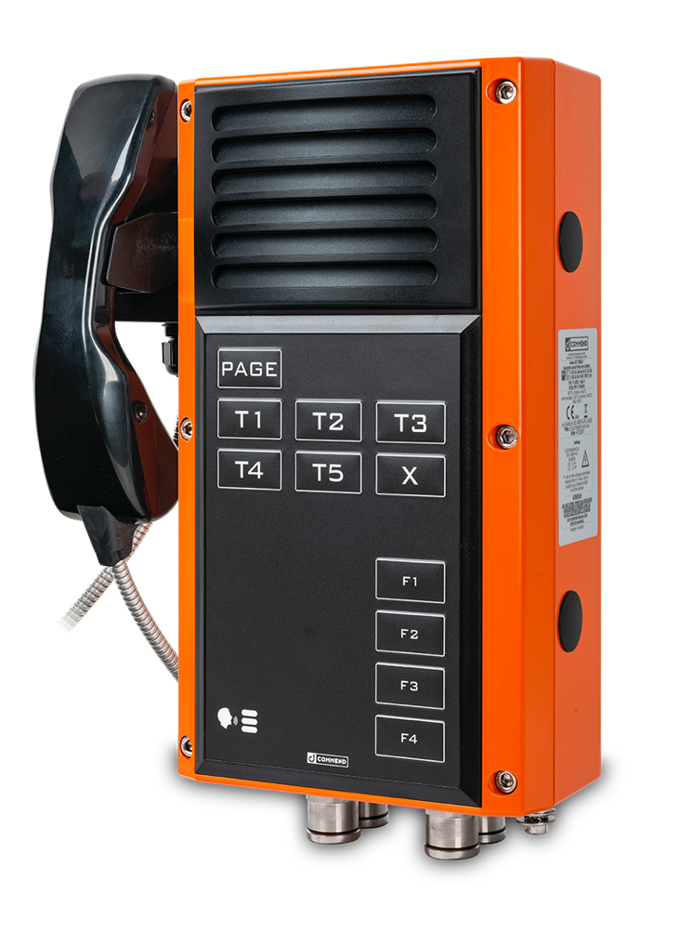
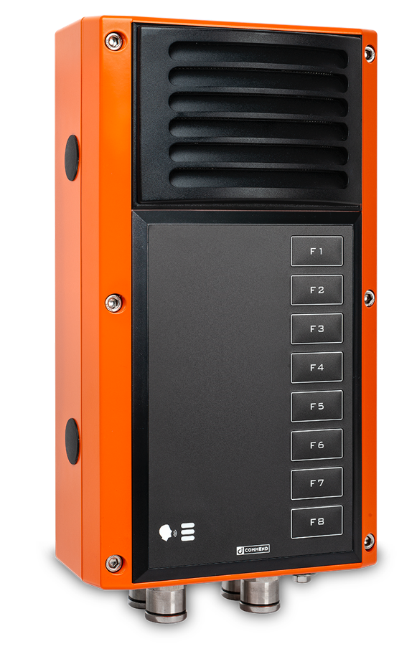
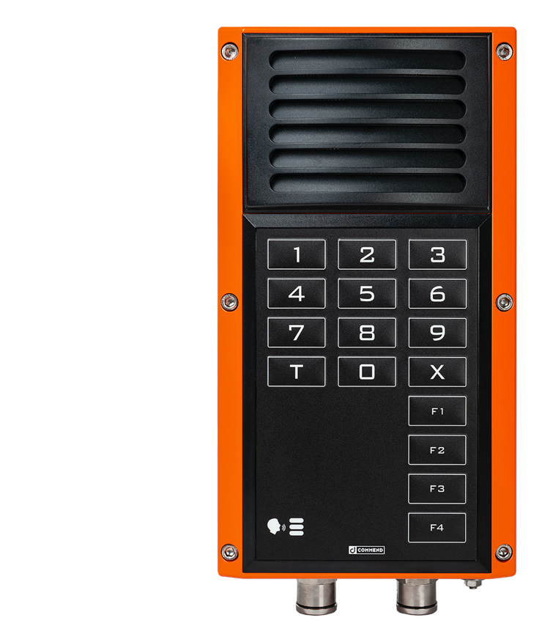
STRONG
...in every respect

Slide 5
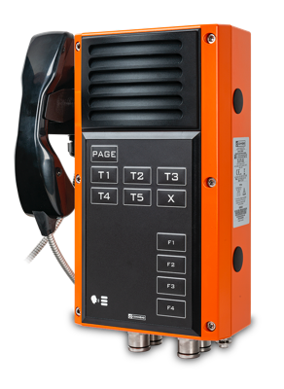
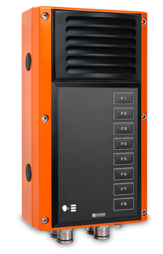
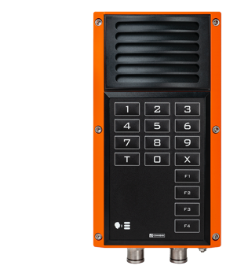
STRONG
T6 – Highest gas temperature class T80°C – Highest dust temperature class
IP66 – Protected against adverse ambient conditions: water jets, dirt and dust
IK 10
Shockproof. Rugged. Durable.
–20°C to +60°C
Withstands extreme ambient temperatures

Slide 6
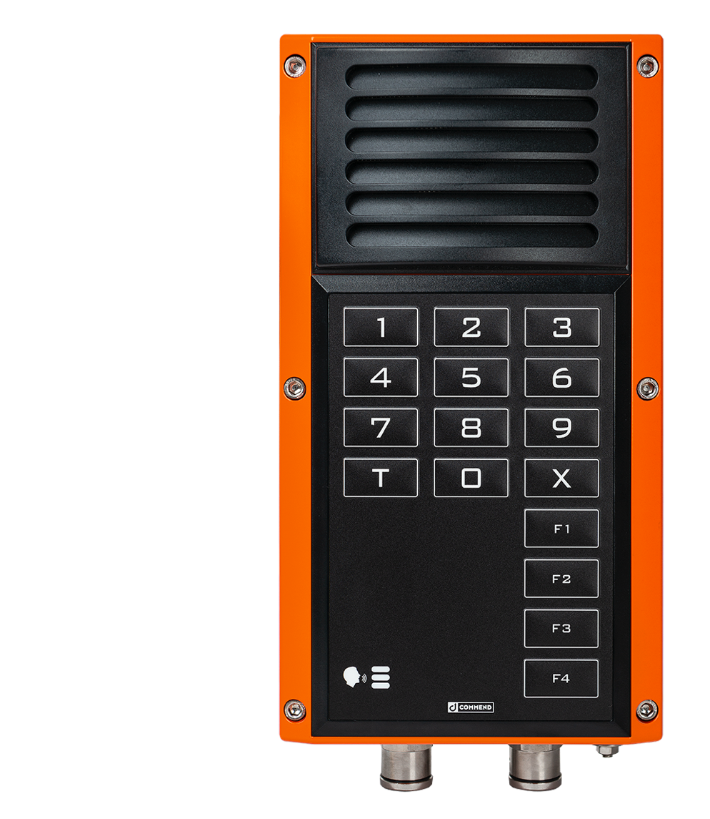
STRONG
Durable double-walled construction made from high-performance polycarbonate
Corrosion-proof
Low weight compared to other Ex-proof Stations
Orange colour ensures highest visibility for optimum security
Cost benefits over the entire product lifecycle
Quicker to install and put into operation
Simple 2-wire cabling
Elimination of expensive Ex d cable glands makes cyclic inspections and maintenance a thing of the past
Automatic function monitoring , line monitoring, loudspeaker and microphone monitoring ..
Large buttons ensure easy operation, even when wearing protective gloves
Notes:
Low weight is a general advantage in terms of handling

Slide 7
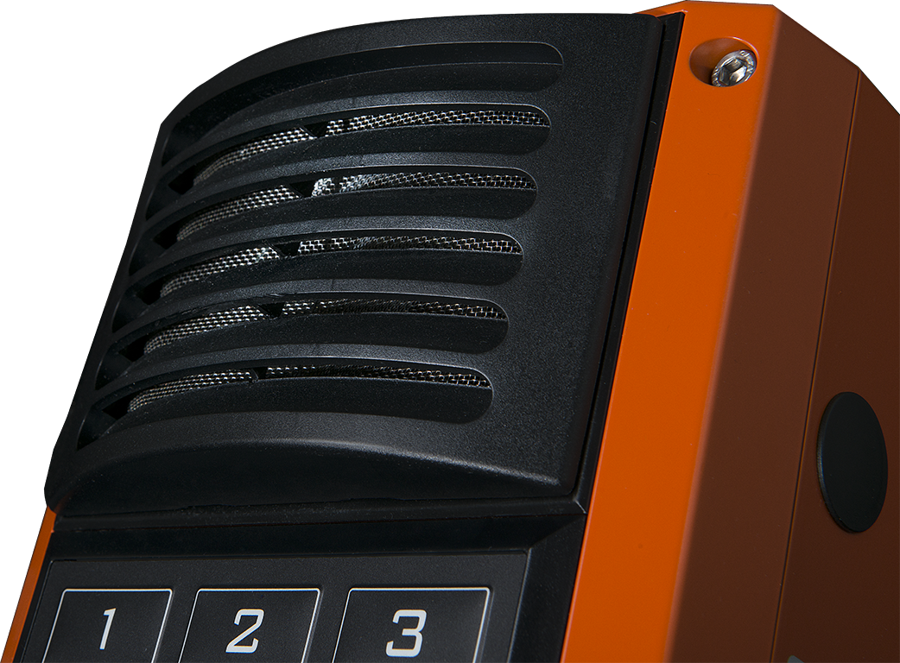
Perfect Speech Intelligibility
Hands-free communication, even at high ambient noise levels
IVC - Intelligent Volume Control
Volume level automatically adjusts to changing ambient noise conditions
Extra-High volume output
Powerful enough to eliminate the need for external loudspeakers
Integrated loudspeaker and Class-D amplifier provide a sound pressure level of up to 110 dB/0.3 m (100 dB/1m)

Slide 8
Perfect Speech Intelligibility
in areas with over 110dB of ambient noise level
Direct connection of a separate loudspeaker
Dedicated powerful Class-D amplifier for connection of external 20 Watts loudspeaker for Public Address and paging
16 kHz eHD Voice Quality
Handsfree OpenDuplex®and Simplex Speech options
Microphone: fully dustproof & watertight
Can be configured as a noise-cancelling microphone
Notes:
High audio bandwidth, conversation modes,

Slide 9
Secure, direct and fast communication
Connected at the push of a button
Notes:
No waiting times as with Ex telephones
Direct dialling
Dynamic call forwarding (if line is engaged or call is not answered)

Slide 10
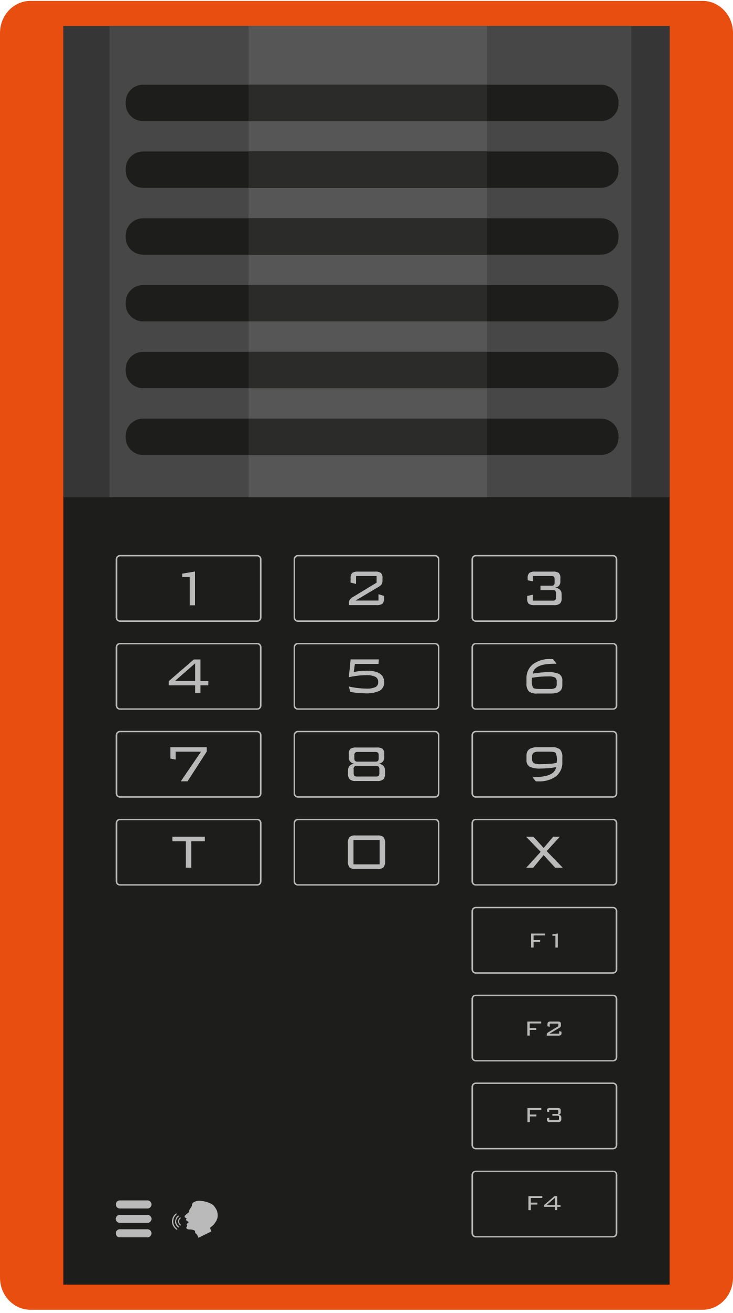
“Classic” wiring of traditional systems
Multiple cables and expensive
I/O
Data
Notes:
10

Slide 11
EX 7000 as a communication hub
Simplified wiring means cost savings
Separate loudspeakers connect directly to integrated dedicated 20-Watt amplifier
Direct connection and control of beacons and signal lights
Active monitoring of input signals (e. g., sensors)
Emergency power supply over 2-wires
I/O
Data
Control of output signals (e.g., sirens)
2-wire support for extended line lengths
Notes:
11
Emergency power supply: Communication and Public Address (internal loudspeaker) are sustained at only 15 dB less volume (85 dB)

Slide 12
Integrates easily into existing IP infrastructures
Leverage existing IT network means cost-savings
IP Converter (optional)
I/O
2-wire
Ethernet
Data
Notes:
12

Slide 13
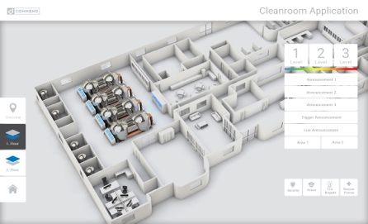
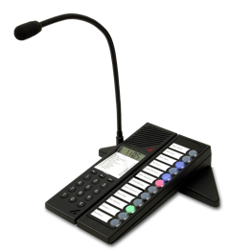
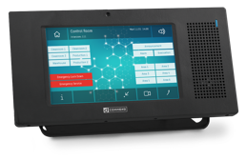
Integrates easily into existing IP infrastructures
Simplified, secure and cost-saving wiring
Central hardware-based and software-based Control Desks for uniform overall control
IP Converter
I/O
2-wire
Ethernet
Data
Software Intercom Server for virtualised IT infrastructures
or ‘classic’ hardware servers
Notes:
13

Slide 14
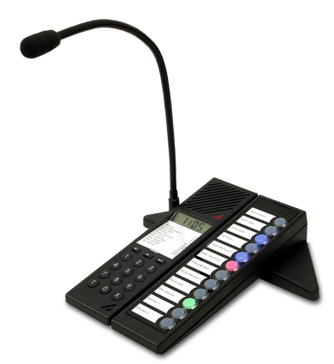
Visualisation & Central Control
Centralised software and hardware solutions
Public Address with zone selection
Intercom
Alarm equipment, e.g., beacons, sirens etc.
Automation
Security
e.g. gates, doors, etc.
IRM Solutions for Incident Response Management
Third-party systems, e.g., VMS, access control, etc.
Notes:
14

Slide 15
Public Address
Centralised software and hardware solutions
Calls to any area, or groups of areas
by simple zone selection
Dynamic announcements at a simple click of the mouse
On-the-fly recording of voice messages enables custom tailored announcements for individual situations
Making your announcements heard
with the help of individual pre-recorded voice messages
Event-based announcements
e.g., A warning when entering a hazardous area – triggered by proximity sensor – “Caution – you are about to enter a hazardous area.”
Scheduled announcements
Announcements for scheduled playback and during specific planned events.
Visualization
Simple, 2-D or 3-D Graphics
Multiple layers/plans
Pre-defined Workflows, Scheduling,
Recording, Event Logging
... and much more ...
Notes:
15

Slide 16
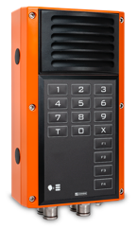
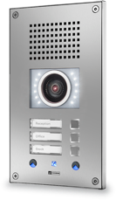
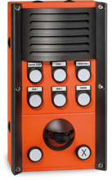
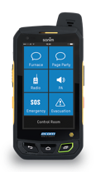
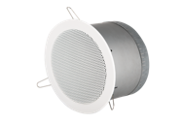
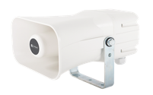
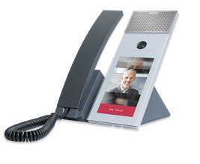
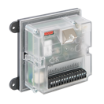
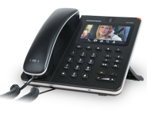
Industrial Ex-proof Stations
Central Overview and Control
Door & Gate Stations
Industrial Stations
Incident Response Management (IRM)
Operational Intercom
Page / Party Line
Emergency Calls
Access Control
Beacons and Sirens
Apps for Ex-proof Smartphones and Ex-proof Tablets
Amplifiers and loudspeakers for Ex and non-Ex Zones
ONE Platform
PA, Alarms, Announcements, People location ...
Mobile Communication
IP-PA loudspeakers
Mobile Radio (DMR, TETRA, Analogue)
Communication in Office Areas, Warehouses, ...
Lifts Alarm Call
Desk and Wallmount Stations
Integration with 3rd party systems (CCTV, BMS, ...)
Build-in Modules
Call Forwarding to Telephones, PBX-Systems, PSTN
Monitoring Inputs, Controlling Outputs
Networking with other Sites

Slide 17
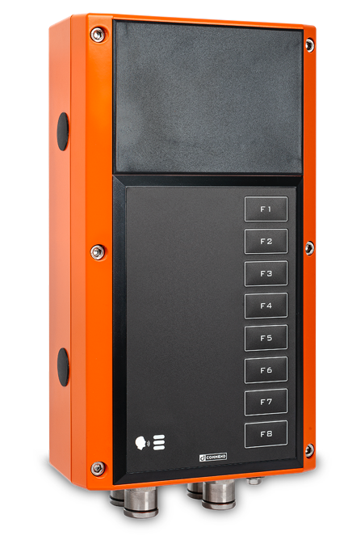
Variants
To suit individual project and communication needs
With or without integrated loudspeaker
With or without handset
Zone 1/21 or Zone 2/22
Three Keypad Layouts: Direct Dialling : Full Keypad : Paging
100 – 240 V AC or 22 – 60 V DC
Point to Point
Conferences
Paging
Party-Line
PA
…

Slide 18
Providing more than 150 Commend functions based on 40 years of experience.

Slide 19
Seriously different
Developed specifically for challenging environments
Perfect speech intelligibility
Wide range of functions and connection options
Cost-saving and future-oriented

Slide 20
A revolutionary new series of Ex-proof Stations
Designed and manufactured in Austria

