Slide 1








Open for any interface
Video – Audio – Data
OPC
TETRA
Notes:
In security and communication systems, it is essential that different systems work together.
Constantly exchanging data, video and audio streams, these systems utilise their full potential in well-coordinated interplay to provide perfectly integrated solutions for operators and users.
Intercom Servers are not just ‘audio professionals’, they also function as interface managers to integrate seamlessly into the work-flows of security applications.

Slide 2
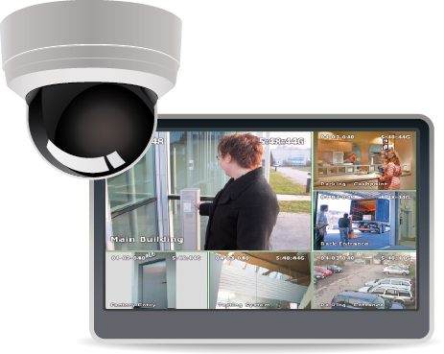

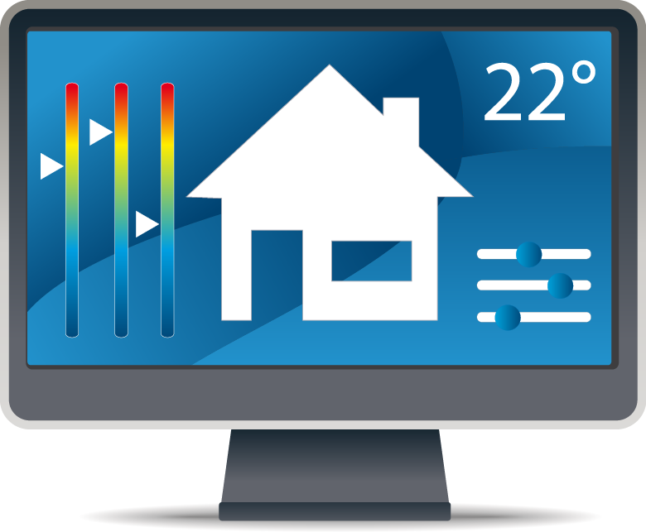






Standard and individual Interfaces
Interfaces and Integration
Video
Audio
Building Management
VoIP/SIP-Server
VoIP/SIP Telephones
Analogue Telephones
Mobile Telephones
Public Landline Network
Inputs and Outputs for control and messaging purposes
Access management for barriers and doors
Analogue Mobile Radio and TETRA
Notes:
Commend Intercom System supports standards such as OPC, SIP and TETRA, as well as a wide spectrum of existing, well tested interfaces to third-party systems.

Slide 3

ICX Protocol
The Intercom eXchange Protocol
The InterCom eXchange Protocol (ICX) is an open protocol for implementing interfaces between third-party systems and Commend Intercom Systems.

Slide 4

Options for any future interface
Interfaces and Integration
SDK
External System
Implementation
Implementation
External System
SDK
Notes:
As a result, Commend Interfaces provide a convenient way of implementing tailored audio, data and video interfaces that meet any individual requirements.
Supported options range from the use of simple signal contacts for control and messaging purposes to the full integration of third-party systems.
The integration can be realisied at the external system or at the Commend one.

Slide 5










Selection
Supported Interfaces and Standards
OPC
TETRA
All product and company names mentioned in this document are trademarks or registered trademarks of their respective owners.
Notes:
Selection of supported interfaces

Slide 6
SIP PBX compatibility
Embracing the SIP world
Digium
Asterisk
Cisco
CUCM
Avaya
Aura
Alcatel
OmniPCX
Mitel
Siemens
Hipath
3CX
Starface
Aastra
MX-ONE
Kamailio
FreeSWITCH
ELMEG
Gigaset
AVM
Fritz!Box
Innovaphone
Virtual Appliance IPVA
Notes:
Commend SIP stations can be used with a wide range of SIP PBX systems.
We are constantly conducting comprehensive tests with SIP servers of different manufacturers. The list keeps growing longer while ensuring uncompromising compatibility.

