Slide 1


Slide 2
approx.
75 %
of Workloads Virtualized
Trend of Virtualization
Notes:
Source: Rough forecast for 2014 from VMWare back in 2012 (VMWare customer survey)

Slide 3

The world’s first
Software Intercom Server
Notes:
Our Solution: we were the first provider worldwide to introduce a fully software-based Intercom Server.

Slide 4




VirtuoSIS
Ready for
vSphere 5.x
XenServer 6.x
Hyper-V
NEW
Notes:
The following virtualisation environments are supported:

Slide 5
VirtuoSIS
Software Intercom Server
Scalability
Challenge
Limits and fluctuating costs for hardware expansion
VirtuoSIS
Linear costs with licences
Expandable at the click of the mouse
Availability
Flexibility
Efficiency

Slide 6
VirtuoSIS
Software Intercom Server
Scalability
Challenge
Downtime costs with
non-redundant systems
VirtuoSIS
Runs on redundant and
fault-tolerant IT infrastructures
Availability
Flexibility
Efficiency

Slide 7
VirtuoSIS
Software Intercom Server
Scalability
Challenge
No stand-by server for maintenance
VirtuoSIS
Redundant server available
Easy migration / easy backup
Multiple virtual machines and Intercom servers
Availability
Flexibility
Efficiency

Slide 8
VirtuoSIS
Software Intercom Server
Scalability
Challenge
Low resource utilisation of dedicated servers
VirtuoSIS
Cost sharing of resources with existing IT infrastructure (hardware and rack space, energy, IT staff, maintenance, etc.)
Availability
Flexibility
Efficiency

Slide 9



VirtuoSIS
An efficient and economical ‘housemate’ sharing
a home with other virtualised servers
SAP ERP
Apache Web Server
rv
Windows Server (OS)
Linux (OS)
Virtual Machine 1
Virtual Machine 2
Notes:
A virtualisation environment typically houses several virtual machines, which may run different operating systems and serve different purposes.
The example on this slide shows SAP running on a Windows operating system and an Apache web server running on Linux.
The VirtuoSIS server installs very easily into this environment, using a pre-configured template.

Slide 10
VirtuoSIS
An efficient and economical ‘housemate’ sharing
a home with other virtualised servers
SAP ERP
Apache Web Server
VirtuoSIS
Windows Server (OS)
Linux (OS)
Linux (OS)
Virtual Machine 1
Virtual Machine 2
Virtual Machine 3
Notes:
The operating system is Linux (specifically, the Debian distribution).

Slide 11
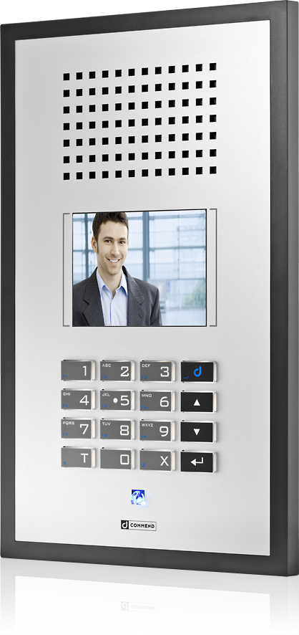
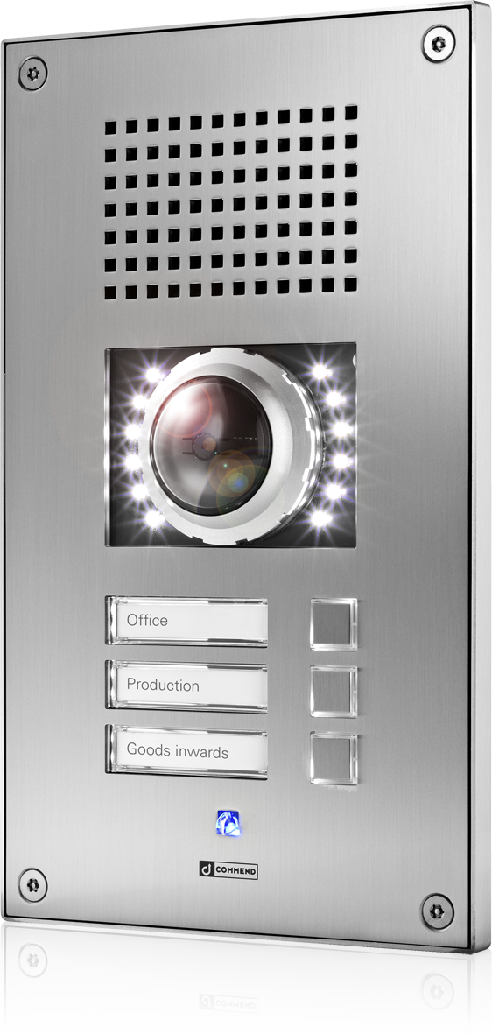
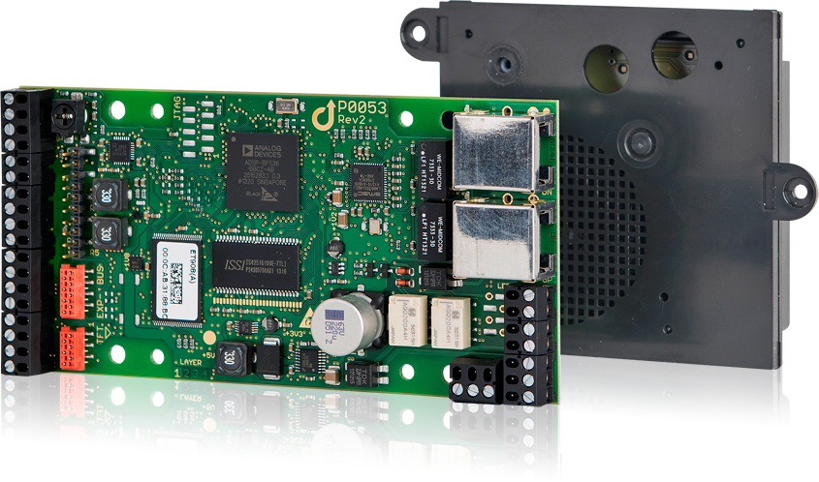
Connectivity
IPv6
ready
Making full use of all Intercom functions
IoIP® Intercom stations
SIP stations
Digital 2-wire and 4-wire Intercom stations
Inputs/Outputs
NEW
VirtuoSIS
IoIP®
2-wire
SIP
4-wire
Notes:
The entire range of IP stations is fully compatible
Commend IP converter ET 901 also enables the use of digital 2-wire and 4-wire stations
So, VirtuoSIS supports all Intercom stations, without any exceptions. Heavy industry, Modules... ‒ wherever.
VirtuoSIS just works ‒ everywhere.
In-/outputs remain fully usable, even within a completely virtualised Intercom world.
Alternatively, an ET8E8A can be connected via an ET901.
Even more in/outputs can be provided by installing a GE 800 Intercom Server with I/O cards.

Slide 12


SIP Connectivity
NEW
Trunks and Clients
VoIP integration via SIP trunk connection to
IP telephone systems and service providers
VoIP connection to public telephone network via SIP gateways
Direct support of SIP stations
VirtuoSIS

Slide 13

Connectivity
Interfaces
Integration of/into external systems via ICX IP interface
Standard and custom-made interfaces for audio – video – data
Audio recording with ComREC
NEW
VirtuoSIS
External systems

Slide 14
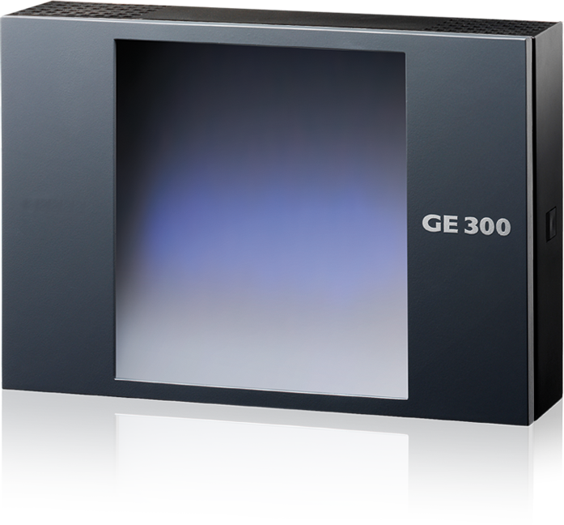
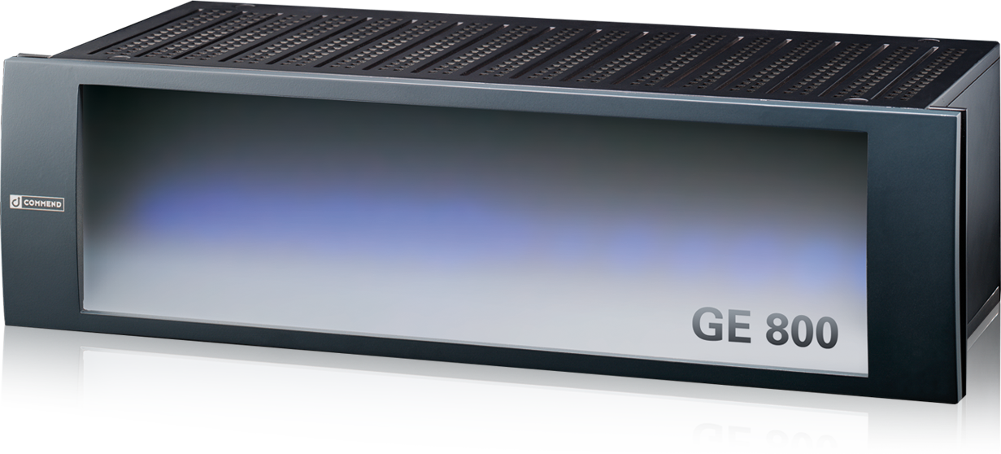
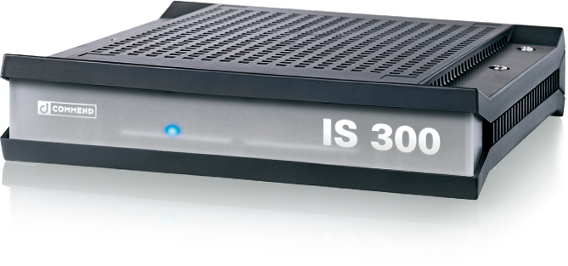
Perfect Networking
via LAN/WAN with Hardware Servers
Notes:
In case you already have an Intercom system, you can use VirtuoSIS to virtualise it. Simply plug in your existing system ‒ that’s it.
In case you are planning a new Intercom system, you also have the option of running a dedicated on-site Commend hardware server, nerworked in combination with a VirtuoSIS.

Slide 15
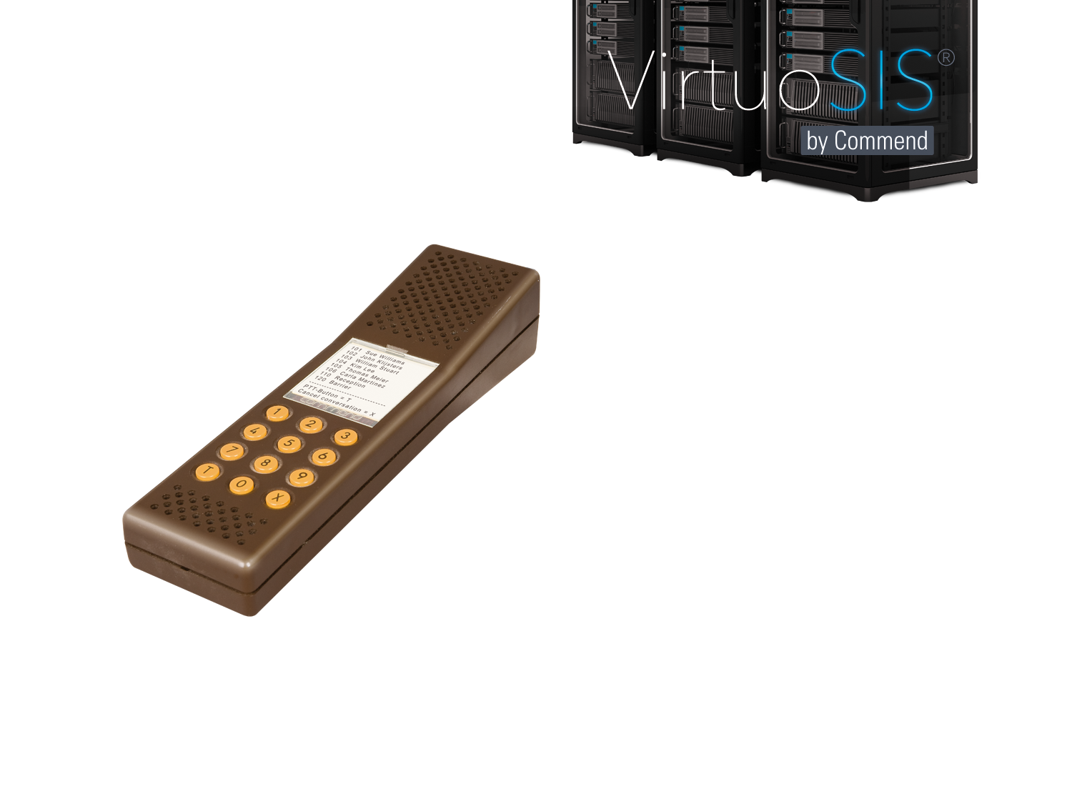
Backward Compatibility
Back to the 80s
Investment Protection
Compatible even with older server generations
Existing equipment can easily
be integrated or migrated
Notes:
Even compatible with older-generation GE 700 and GE 200 Intercom servers.
Even 4-wire stations from the 1980s can be connected and used by way of an ET901 IP converter.

Slide 16
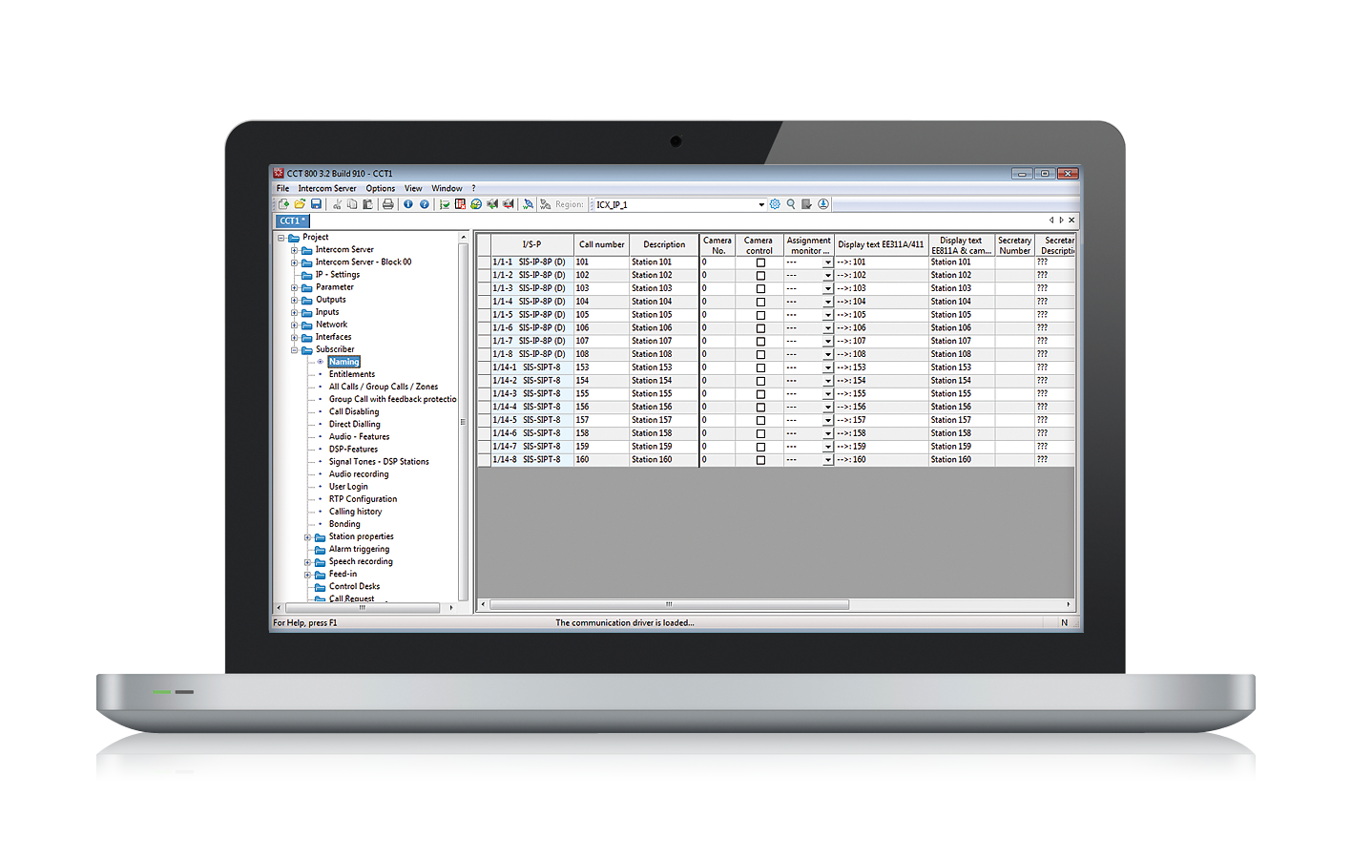
VirtuoSIS
Configuration and Monitoring
Configuration via broadly used Commend Configuration Tool (CCT)
System Monitoring via integrated Web-Interface
Notes:
VirtuoSIS can be configured via the well-known “CCT” tool, which is commonly used by technicians.

Slide 17




112 Subscribers
1 GHz CPU
1 GB Memory
10 GB Disk Space
1. Instance (112 Subscribers)
Expandable at the
click of the mouse
Additional subscribers can be
added via licences
Simple licensing scheme
VirtuoSIS
Linux (OS)
Virtual Machine 3
Notes:
Units of 8 or 32 subscribers can be added by obtaining a licence.
One instance can manage up to 112 subscribers.
As mentioned, VirtuoSIS is very economical in terms of resource requirements. One instance requires only 1 GHz CPU capacity and 1 GB of Memory.

Slide 18
112 Subscribers
224 Subscribers
336 Subscribers
448 Subscribers
560 Subscribers
672 Subscribers
784 Subscribers
896 Subscribers
1,008 Subscribers
10. Instance (112 Subscribers)
1,120 Subscribers
9. Instance (112 Subscribers)
1 GHz CPU
2 GHz CPU
3 GHz CPU
2 GHz CPU
2 x 2.5 GHz CPU
2 GHz CPU
3 x 2.5 GHz CPU
3 x 2.7 GHz CPU
3 x 3 GHz CPU
8. Instance (112 Subscribers)
4 x 2.5 GHz CPU
7. Instance (112 Subscribers)
1 GB Memory
1.25 GB Memory
1.5 GB Memory
1.75 GB Memory
2 GB Memory
2.25 GB Memory
2.5 GB Memory
2.75 GB Memory
3 GB Memory
3.25 GB Memory
6. Instance (112 Subscribers)
5. Instance (112 Subscribers)
10 GB Disk Space
10 GB Disk Space
10 GB Disk Space
10 GB Disk Space
10 GB Disk Space
10 GB Disk Space
10 GB Disk Space
10 GB Disk Space
10 GB Disk Space
10 GB Disk Space
4. Instance (112 Subscribers)
3. Instance (112 Subscribers)
2. Instance (112 Subscribers)
1. Instance (112 Subscribers)
VirtuoSIS
Scalable
Up to 10 instances per virtual machine
Linux (OS)
Virtual Machine 3
Notes:
Up to 10 instances can be managed per virtual machine.
This means a maximum of 1,120 subscribers per virtual machine. Even at that level ‒ with more than 1,000 subscribers ‒ the resource requirements remain comfortably low.

Slide 19
1,120 Subscribers
10. Instance (112 Subscribers)
1,232 Subscribers
9. Instance (112 Subscribers)
4 x 2.5 GHz CPU
8. Instance (112 Subscribers)
4 x 2.7 GHz CPU
7. Instance (112 Subscribers)
3.25 GB Memory
4.25 GB Memory
6. Instance (112 Subscribers)
5. Instance (112 Subscribers)
10 GB Disk Space
2 x 10 GB Disk Sp.
4. Instance (112 Subscribers)
3. Instance (112 Subscribers)
2. Instance (112 Subscribers)
1. Instance (112 Subscribers)
1. Instance (112 Subscribers)
VirtuoSIS
VirtuoSIS
Linux (OS)
rv
Linux (OS)
Virtual Machine 3
Virtual Machine 4
Notes:
What if even more subscribers are needed?
No problem ‒ setting up another virtual machine with a few mouse clicks adds the same scalable subscriber capacity to the existing one.

Slide 20
1,232 Subscribers
2,240 Subscribers
10. Instance (112 Subscribers)
10. Instance (112 Subscribers)
2,352 Subscribers
9. Instance (112 Subscribers)
9. Instance (112 Subscribers)
4 x 2.7 GHz CPU
8 x 2.5 GHz CPU
8. Instance (112 Subscribers)
8. Instance (112 Subscribers)
8 x 2.7 GHz CPU
7. Instance (112 Subscribers)
7. Instance (112 Subscribers)
4.25 GB Memory
6.5 GB Memory
7.5 GB Memory
6. Instance (112 Subscribers)
6. Instance (112 Subscribers)
5. Instance (112 Subscribers)
5. Instance (112 Subscribers)
2 x 10 GB Disk Sp.
2 x 10 GB Disk Sp.
3 x 10 GB Disk Sp.
4. Instance (112 Subscribers)
4. Instance (112 Subscribers)
3. Instance (112 Subscribers)
3. Instance (112 Subscribers)
2. Instance (112 Subscribers)
2. Instance (112 Subscribers)
1. Instance (112 Subscribers)
1. Instance (112 Subscribers)
1. Instance (112 Subscribers)
VirtuoSIS
VirtuoSIS
VirtuoSIS
Linux (OS)
Linux (OS)
Linux (OS)
Virtual Machine 3
Virtual Machine 4
Virtual Machine n
Notes:
If this capacity is used up as well, additional virtual machines can be added as needed.

Slide 21



Licence Scheme
2. Instance (up to 112 subscribers)
8
8
8
8
8
8
8
Simple and Flexible
8 subscribers
feature levels B-C-D
8
8
8
8
8
8
8
8
1. Instance (up to 112 subscribers)
8 WAN connections
8
8
8
8
4
8
8
8 LAN connections
8
8
8
8
8
8
8
8
SIP trunks for 8 channels
8
1 ICX interface
VirtuoSIS
Basic Professional Licence
1
Server independent licences
(Intercom Client, ComWIN, OPC,
L-IP-REC-1, L-IF-PELCO, …)
Virtual Machine
Notes:
You need a Basic Professional Licence per Virtual Machine
Following licences can be used in the several instances
Subscriber
WAN connections
LAN connections
SIP trunks
ICX interfaces
Server independent licences (Intercom Client, ComWIN, OPC)

Slide 22

Up to 25,000 subscribers
You decide the size of your Intercom orchestra
Notes:
Up to 25,000 subscribers: In terms of subscribers, VirtuoSIS is just as scalable as our hardware servers. Up to an amazing 25,000 subscribers ‒ all with a simple click of the mouse!
Similar to an orchestra that can be supplemented by additional musicians as needed, VirtuoSIS lets you scale your system to your requirements quickly and easily to suit your Intercom needs.

Slide 23
Commend Software
Other Intercom “neighbours”
ComREC
NEW
ComREPORT
VirtuoSIS
ComWIN
Linux (OS)
Windows Server (OS)
Virtual Machine 3
Virtual Machine n
Notes:
In addition to running VirtuoSIS, you can set up additional virtual machines to run other Commend applications ‒ for example:
ComWIN for virtualising the Intercom System
ComREPORT for logging all Intercom System events, and many more
ComREC for audio recording via ICX and RTP
Operating system in this case is Windows

Slide 24
Hot and Cold Stand-by
Security and Efficiency
LIVE
Stand-by
3. Instance (112 Subscribers)
3. Instance (112 Subscribers)
2. Instance (112 Subscribers)
2. Instance (112 Subscribers)
1. Instance (112 Subscribers)
1. Instance (112 Subscribers)
VirtuoSIS
VirtuoSIS
PRO 3.2
PRO 3.2
Linux (OS)
Linux (OS)
Virtual Machine 3
Copy of Virtual Machine 3
Notes:
We use the same reliable storage and migration options that are provided within the virtualised IT infrastructure.
Entire virtual environments can be backed up and migrated reliably without any interruptions.
In this case we created a copy of the primary virtual machine (LIVE).

Slide 25
Maintenance
Security and Efficiency
Updates and Extensions
LIVE
4. Instance (112 Subscribers)
3. Instance (112 Subscribers)
3. Instance (112 Subscribers)
2. Instance (112 Subscribers)
2. Instance (112 Subscribers)
1. Instance (112 Subscribers)
1. Instance (112 Subscribers)
VirtuoSIS
VirtuoSIS
PRO 3.2
PRO 4.0
PRO 3.2
Linux (OS)
Linux (OS)
Virtual Machine 3
Copy of Virtual Machine 3
Notes:
In the case of an update, the secondary virtual machine takes over the operation.
Now you can comfortably update the software and/or add an additional instance at the the primary virtual machine.

Slide 26
Maintenance: done
Security and Efficiency
LIVE
Stand-by
4. Instance (112 Subscribers)
4. Instance (112 Subscribers)
3. Instance (112 Subscribers)
3. Instance (112 Subscribers)
2. Instance (112 Subscribers)
2. Instance (112 Subscribers)
1. Instance (112 Subscribers)
1. Instance (112 Subscribers)
VirtuoSIS
VirtuoSIS
PRO 4.0
PRO 4.0
Linux (OS)
Linux (OS)
Virtual Machine 3
Copy of Virtual Machine 3
Notes:
The maintenance is done, the primary virtual machine takes over and you can create again a copy of this.
An even more powerful feature is Fault Tolerance from VMWare (Version 4 and higher). Also here a copy of the primary virtual machine is running on a second host (but not active). This machine is permamently synchronized with the primary virtual machine over the network and takes over seamlessly in case of an outage of the primary VM's host.

Slide 27

Sustained Intercom performance, thanks to Fault Tolerance*
Even in case of a server failure,
ongoing conversations will
continue uninterrupted
* Depending on the virtual IT-Infrastructure (Hypervisor)
Notes:
Just like an emergency parachute helps paragliders to land safely in case of problems, VirtuoSIS will make sure your message will ‘land’ safely at the destination terminal in case of system problems.
‘Fault Tolerance’ is possible due to the low resource requirements of VirtuoSIS

Slide 28
Reduced overheads
Low Total Cost of Ownership – TCO
Hardware
Energy
IT Staff
Redundancy & Downtime
approx.
40 %
TCO savings*
Thanks to integrated
redundancy and high utilization of existing resources (staff, energy, computing resources)
Hardware
Energy
IT Staff
Redundancy
& Downtime
* Compared to a redundant system concept based on GE 800 servers and 100 subscribers.
Notes:
On the one hand, VirtuoSIS is amazingly scalable and powerful. On the other hand, it remains on a very low level where overhead costs are concerned.
Also, it is cost-optimised in terms of resources such as hardware, energy and personnel, which keeps the TCO down.
This is achieved by:
Following the uniform hardware concept of the IT environments // supports quick & easy hardware replacement
Enabling VirtuoSIS to scale quickly and easily to any size on a simple licence basis - there’s no need for additional server hardware (except for minimum resource requirements in terms of CPU, Memory and hard disc space)
Requiring maintenance of only one IT infrastructure, which allows for optimum use of IT personnel
Automatic use of built-in security and fail safety mechanisms within the virtualisation environment ‒ this ensures ultimate availability.
Again, the uniform security concept (planning and maintenance) helps save hardware and personnel resources.
This enables significant cost savings when it comes to the essential high availability.

Slide 29

Downtime costs money
VirtuoSIS provides best TCO thanks to
redundant IT infrastructure
Critical
Parking, Emergency Call Systems, Prisons, ...
Costs
€K
Very important
Lifts, Production, ...
TCO with Software
Intercom Server
on redundant IT
infrastructure
Important
Door Communication, ...
Not essential
Office Communication, ...
TCO with
non-redundant
hardware server
Years
Notes:
Downtime costs money (depending on application); redundancy is therefore important
SIS provides TCO advantages in redundant systems

Slide 30





References
VirtuoSIS used successfully in 30+ installations worldwide
Building Security
Parking
Heavy Industry
Airport
Railway
Notes:
Airport: Auckland (New Zealand)
Parking: Wilson Parking (Australia)
Railway: NMBS Main Railway Station (Belgium)
Heavy Industry: Mannstädtwerke (Germany)
Buidling Security: Knorr Bremse AG (Germany)
Petrol Stations (Austria)
Buidling Security: Novartis (USA)

Slide 31
The world’s first
Software Intercom Server

